Slide 1
Braunton Academy
GCSE GEOGRAPHY CASE STUDIES

Slide 2
Braunton Academy
GCSE GEOGRAPHY CASE STUDIES
POPULATION & SETTLEMENT

Slide 3
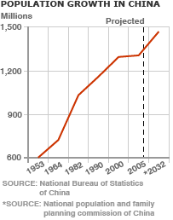
Why was Chinas population controlled?
China had to control its population as the country was increasing and increasing. In the 1950s, China wanted to improve its wealth; the President thought the country had too many people to increase its wealth.
-There were more people in China than the combined population of Europe, the Americas and Japan.
-The population was creeping quickly to 1 Billion people.
Reasons why China thought it wouldn’t become rich with a big population
-Need more food which means they couldn’t sell a lot to other countries
The government would have to spend a lot of money on health care and education.
Wouldn’t be enough jobs for everyone so the government would have to pay benefits
China's One Child Policy
Population management
Has it worked?
The birth rate in China has fallen since 1979, and the rate of population growth is now 0.7%.
China's one-child policy has been somewhat relaxed in recent years. Couples can now apply to have a second child if their first child is a girl, or if both parents are themselves only-children.
While China's population is now rising more slowly, it still has a very large total population (1.3 billion in 2008).
The One child Policy
In 1979 the Chinese government introduced the One Child Policy. This meant each couple could only have one child.
If couples had more than one child they would have to pay fines or they would force the mother to have an abortion. You had to be married and over 25years to have children.
If couples had one child they would get free healthcare, education and money.
Married couples in the countryside were allowed 2 children as the government saw that children were needed to help with farming.
As families were only allowed one child, most wanted a boy to keep on the family name, so if women found out they were having a girl they would adopt or abort the baby. This now has created a large population of males and not enough females. In 2000, it was reported that 90% of foetuses aborted in China were female. Today it is thought that men outnumber women by more than 60 million.

Slide 4
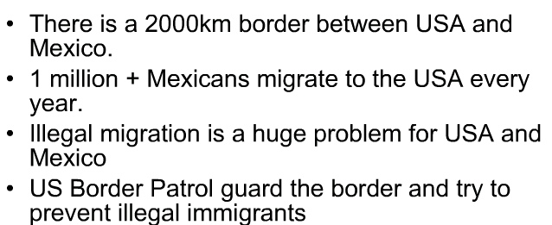
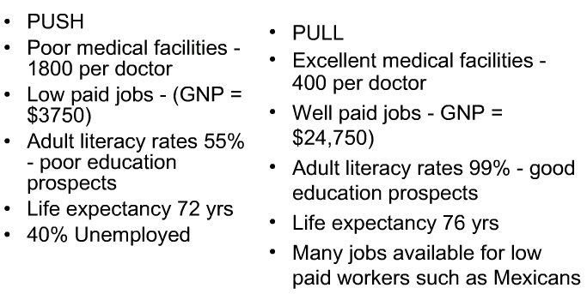
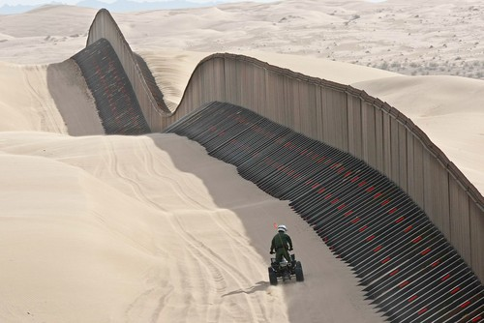
International Migration (Outside the EU)
Mexico to the USA
The US Government spends over $3.7 billion each year defending the USA- Mexico Border.
What are the impacts on the USA
- Illegal migration costs the USA millions of dollars for border patrols and prisons
-Mexicans are seen as a drain on the USA economy
-Migrant workers keep wages low which affects Americans
-They cause problems in cities due cultural and racial issues
-Mexican migrants benefit the US economy by working for low wages
-Mexican culture has enriched the US border states with food, language and music
-Remittances are sent home which is $$ not spent in the USA.
The border is guarded by more than twenty thousand border patrol agents, more than any time in its history. They only control around 700 miles of the 1954 mile border.
What are the impacts on Mexico?
-The Mexican countryside has a shortage of economically active people
-Many men emigrate leaving a majority of women who have trouble finding marriage partners
-Young people tend to migrate leaving the old and the very young
-Legal and illegal immigrants together send some $6 billion remittances a year back to Mexico, which strengthens their economy
-Certain villages such as Santa Ines have lost 2/3 of its inhabitants
-It is the most frequently crossed international border in the world, with approximately three hundred fifty million (350,000,000) crossings per year.

Slide 5
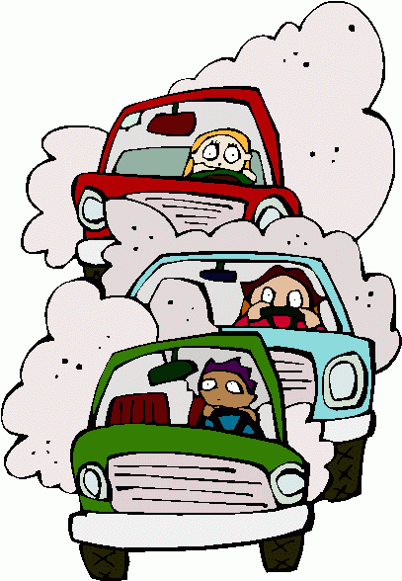
Internal migration
Rural ---> Urban China
for work
Chinese cities will face an influx of another 243 million migrants by 2025, taking the urban population up to nearly 1 billion people
The government are increasing internal migration by land-sale policies, infrastructure investment and the incentives offered to local government officials
Pull factors influencing migration of people from rural areas to large cities are
Better employment
better education, -business opportunities -higher standard of living
In rural (villages) areas there are push factors. Few jobs are available, as machinery as took over. 150 million rural people unemployed. Lower wages and therefore greater poverty – 26 million live in poverty. Shortage of services such as schools (1.1 million children don’t go to primary school) and health facilities
Between 1990 and 2006 the percentage of people living in urban areas in China increased from 26% to 44%.
Urban area positives include-
the economy grows. More workers and an increase in demand for services –this increases trade and industry.
In rural areas positives include 130 million have left and send money home. This increases income for some households. Also less pressure on the land. Negatives include it is usually young people who migrate, leaving an ageing population. Half of Chinese people over 60 live without any younger relative to look after them.
Negatives
-Traffic
-Pollution
Overcrowding
Shortage of jobs
Pressure on services
Lack of housing
270 cities have no water plant treatment so sewage is dumped straight into the river.
The Chinese government managed urbanisation by building water supply plants, improving education and transport. Electricity has improved in cities. Money has also been spent on improving housing.
They have tried to improve rural areas by setting up pension schemes, investing in business, land reforms and trying to reduce poverty.
There is large scale
poverty in rural villages
Now there are many
'empty villages'

Slide 6
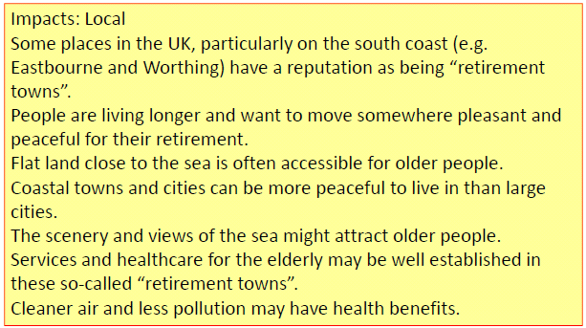
Internal migration
North UK to South UK
Due to retirement
Many people plan to spend their retirement in a different area.
43% of 50+s move away
when they retire
The south-west counties of Dorset, Devon and Cornwall are popular
The perceived attractions include:
-a slower pace of life
-the scenery
-the community
-away from the busy larger cities
-lower crime rates
Popular areas for retirement migrants have problems as a result of this:
-pressure on health care
-demand for social services
-an increase in house prices
-a lack of suitable housing
There are also advantages:
there is an increased demand for local services - so the local shop and pubs have more custom
jobs in social care and health care are available
a growth of age related services, such as chiropodists, social groups and bingo
younger retired people spend "the grey pound", spending money through travel and recreation
Local councils have to spend a large proportion of their budget on elderly care whether social services or hospital care
23% of the population in the
SW is retired

Slide 7
Migrants moving from Poland to the UK are classed as economic migrants.
International migration
Between 2004 and 2007 half a million poles arrived
Poland to the UK
The UK has pull factors such as
higher wages of £20,000
low unemployment of 4%.
Higher standard of living
Higher education opportunities
Already a multicultural society
Part of the EU so can enter easily and gain a working visa
Push factors from Poland include -high unemployment of 19%.
-Low wages of £8000
housing shortages with only 300 houses available for every 1000 people
Lack of higher education
Low standard of living
If a country is part of the EU, you can move freely between every country
Impacts to Poland (origin country)
(+) Money is sent back to Poland, this is called remittances, this strengthens their economy (£1bil)
(-) Skilled workers leaving Poland, this is called the Brain drain
(-) Underpopulation, an ageing population in Poland. (82% aged 18-34 migrant from Poland)
(+) Most migrants are temporarily leave Poland, so come back with better skills and money
The UK government attempts to manage immigration. Polish workers have to register under the worker registration scheme. For new EU countries like Bulgaria the government tightened their control and now migrants have to get permission from the home office to work here and it is only granted for certain jobs – where there is a shortage. Other counties manage migration through a point based system based on education, age, language ability etc e.g. Australia. The UK is looking at this. We also have limits and targets set and we control illegal immigration though deportation – here illegal migrants are arrested, jailed and forced to return home.
Impacts to the UK (host country)
(+) Polish migrants contributed £1.9 billion in taxes .
(+) provide skilled workers like plumbers, will do unpleasant jobs like cleaning.
(+) Creates multicultural society
(-) Puts pressure on public services (health, education)
(-) creates tension in the community (e.g they take our jobs)
(-) overcrowding

Slide 8
Braunton Academy
GCSE GEOGRAPHY CASE STUDIES
ECONOMIC DEVELOPMENT

Slide 9
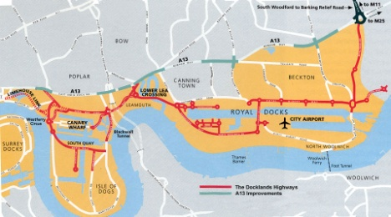
MEDC Land Use Change
Regeneration of London Docklands
In 1981 the London's Docklands Development Corporation (LDDC) was set up to improve the economic, social and environmental problems that had developed in the area that was once one of the world's busiest ports.. The area became on the first Enterprise Zones in 1981. The land was made rate free for ten years.
Why did the London Docks go into decline? 1. An increase in ship size meant they found it difficult to come down the river as far as the Isle of Dogs where the river wasn't as deep. (the position of the docks moved further downstream to Tilbury); 2. Containerisation meant few dockers were needed with large cranes used to lift containers from ships; 3. The decline of portside industries and manufacturing
Social Changes
£10 million spent homes - a total of 22,000 new homes built
of old warehouses to new homes - New shopping centre built
- refurbishment of shopping parades
- - many restaurants, pubs and cafes built - Docklands Sailing and Watersports Centre - £100 million spent on health, education, job training etc
Environmental Regeneration - network of pedestrian and cycle routes
- creation of pedestrian bridges - creation of new open spaces (150ha) - Water based Ecology Park and London's first bird sanctuary at East India Dock Basin - one of 17 conservation areas set up - planting of 200,000 trees; - the area has now received many awards for architecture, conservation and landscaping
Economic Changes
Unemployment had fallen & business increased - transport revolution - opening of the Docklands Light Railway in 1987 - now carrying 35,000 passengers a week; - £7.7 billion in private sector investment -Building of the City Airport
- attraction of financial and high-tech firms, - TV studios and newspapers such as The Guardian now have offices in the prestigious Canary Wharf business complex.
Success
Increase in trade
Large TNCs came
Better transport
Sustainable building (Brownfield sites)
Conservation
Criticisms
Didn’t benefit the original residents, couldn’t afford new houses
No community
High skilled jobs not for old dockers
In the 1980s in an effort to reverse the process
of inner city decline the UK government set up
Urban Development Corporations (known as UDCs).

Slide 10
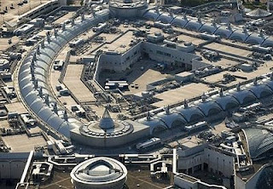
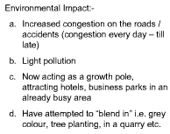
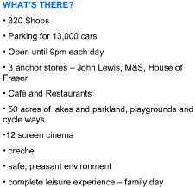
Since the 1980s, much of the retail development in the UK has been in the form of out-of-town developments as land is cheaper, more land is available in the countryside, workers are nearby and good transport links.
Retail Provision Change
Bluewater Shopping Centre
Bluewater, known as Europe's largest retail and leisure complex, opened in 1999, it was built on a brownfield site. It used to be a chalk quarry.
It has excellent access to the market (consumers) and for supply, being just outside the M25 in the area of Dartford.
It has a good catchment area, with over 11 million people within an hours drive.
Bluewater has over
27 million visitors a year
Economic impacts
-Provides jobs in the local
-Gives local income to strengthens the economy through consumers and local council
BUT CBD is struggling as most people go to OOT centre rather than town centre, so urban decay.
Employes over 7000
Trade in the local CBDs have decreased by over 50%
Bluewater is in Kent

Slide 11
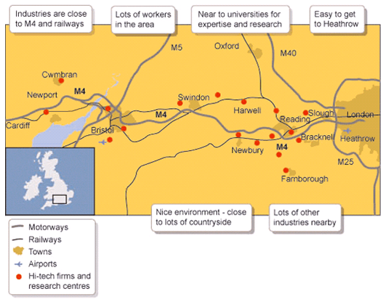
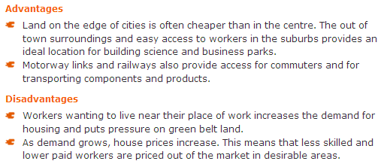
Close to major airports,
so links to the rest of
the World
The corridor is home to companies such as Hewlett Packard and Sony who are involved in research and development (quaternary industry) and have links with universities who provide well-qualified graduates.
Factors that influence economic activity
MEDC - M4 Corridor
The M4 corridor (Heathrow airport in the east to Bath and Bristol in the west).
Also known as the ‘Sunrise Strip’
Companies that are on the M4 corridor, 02 in Slough, Microsoft, INg direct and Ericsson are in Reading. Vodafone in Newbury and Orange in Bristol.
It creates billions of pounds to the UK economy.
Few raw materials are used and therefore transport costs are low, making the industries 'footloose‘ (not tied to a particular location)
Generally attractive environment, trees, lakes, modern buildings. Pleasant to work and live in!
Grows the economy of the local towns, where employers live.
Professional workers selected from Uni’s nearby, eg. Oxford/Cambridge

Slide 12
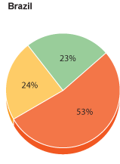
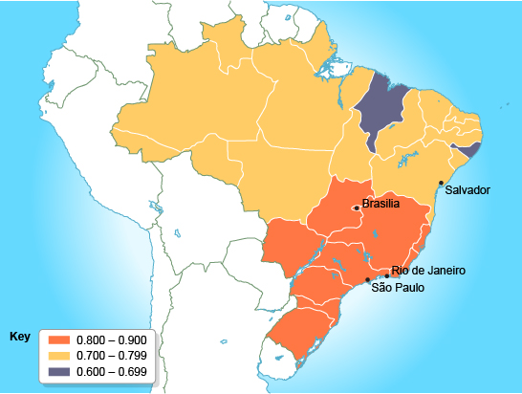
South East Brazil is the economic CORE region of Brazil, it has primary, secondary, tertiary and quaternary industries.
Factors that influence economic activity
LEDC - South East Brazil
More MNCs are located
here than anywhere
else in Brazil
The quality of life and wages are higher than anywhere else in Brazil
Secondary Industries
It is the centre for foreign and national investment in manufacturing.
Investment was concentrated her in the 1950s/60s by the Government. Excellent road and rail links here, as well as the most ports and airports. Solid pipeline for oil and gas.
Car industry is the major activity – Ford, GM, VW, Fiat and Toyota manufacture here.
Other production includes clothing, food , printing and furniture. (Yet decreasing due to competition in AISA)
The periphery is just outside the economic core, where most people live and some industries are located
Primary Industries
What influence the primary industries here?
-Warm temperature
Average rainfall
Rich soils
GREAT FOR FARMING
Coffee, beef, rice, cacao, sugar cane and fruit are grown here
MINING
Large deposits of gold, iron ore, manganese and bauxite make mining very viable here
ENERGY
Oil, gas offshore and hydroelectric power from the large river ensure energy is produced
FOREST/LOGGING
Warm temperatures create the forest
FISHING
-Off the coast many are employed in fishing and supplies food for the locals
Tertiary
Sao Paulo is the largest financial centre in south America. Most headquarters for Brazil’s banks.
Rio de Janerio, Santos, Sao Paulo major cities
Quaternary
Centre of research and development in public & private sectors. San Jose Dos Campos is the key area. The Aerospace Technical Centre is where space & aviation is developed & tested
Map showing Brazil’s
regional Human Development Index
50 years upward growth,
clear multiplier effect
The population is over 72
million and is the largest
in Brazil

Slide 13
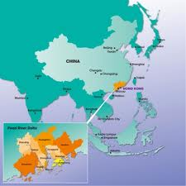
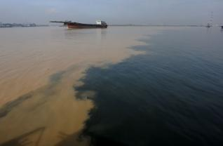
Conflict between economic activity & the environment
The Pearl Delta -China
The Pearl Delta is in the Republic of China in the low-lying area surrounding the Pearl River estuary where the Pearl River flows into the South China Sea. It is one of the most densely urbanised regions in the world and one of the main hubs of China's economic growth.
The Pearl River Delta is notoriously polluted, with sewage and industrial waste. (Treatment facilities are failing to keep up with the growing population).
The Pearl River Delta has become the world's workshop and is a major manufacturing base for products such as electronic products (such as watches and clocks), toys, garments and textiles, plastic products, and a range of other goods.
Much of the area is frequently covered with a brown smog. This has a strong effect on the pollution levels in the delta.
In October 2009, Greenpeace released a report, "Poisoning the Pearl River" that detailed the results of a study it conducted. All samples they took contained hazardous properties including heavy metals such as beryllium, copper and manganese. These substances are associated with a long list of health problems such as cancer, endocrine disruption, renal failure and damage to the nervous system as well being known to harm the environment.
Nearly five percent of the world's goods were produced in the Greater Pearl River Delta in 2001. Over 70,000 Hong Kong companies have plants there.
The industries in the
delta make over
US$448 billion a year
In 2007, the World Bank approved a $96 million loan to the Chinese government to reduce water pollution in the Pearl River Delta. 7.1 billion was spent on the river by mid 2010 to clean up the river's sewage problems. The city will build about 30 water treatment plants, which will treat 2.25 million tonnes of water per day. The program hopes to cut down the amount of sewage in the area by 85%,
Pollution is a great risks
to the Chinese White
Dolphins that inhabit the area.

Slide 14
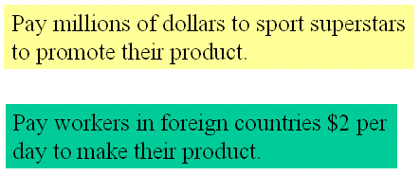
A Multi-National Company (MNC)
Nike
Nike s the world's leading supplier of sports footwear and equipment. The company was founded in 1972. The company name comes from the Greek word for 'victory'. Nike does not make any shoes or clothes itself but contracts out to factories in LEDCs.
“Nike’s Wealth was built
upon the backs of the
worlds poor”
The numbers…
Yearly revenue of $19.2 billion (2009).
Products in 140 countries.
Contracts to 700 factories in 45 countries.
Employing 800.000 people in the supply chain.
These subcontracted companies then act on their own and re-subcontract their
operations in other Asian countries that give low wages and have no employment laws. E.g. Vietnam, The Philippines and Indonesia
The average pay at a Nike factory close in Vietnam is $54 a month, 3x higher than other jobs.
Children as young as 10 making shoes, clothing and footballs in Pakistan and Cambodia
Nike has been accused of
using child labor in the
production of its soccer
balls in Pakistan.
In 1998 Nike changed the minimum age requirements to 17 yrs
Negatives of Nike
- Sweatshops
- Child labour.
- Hazardous working conditions
- Below subsistence wages.
Measures taken by Nike,
Code of conduct.
Decommissioning
Auditing tools and task force.
Nike have hired independent auditors to make sure that the company subcontractors are living up to Nike’s code of conduct.

Slide 15
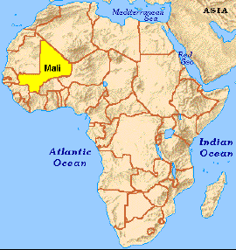
A sustainable aid project
Wateraid - Mali
WaterAid is an international NGO (non-governmental organisation /charity) that focuses on the provision of safe domestic water, sanitation and hygiene education to the world's poorest people.. WaterAid's vision is of a world where everyone has access to safe domestic water and effective sanitation.
In Mali, current national figures indicate that only 50% of the people have access to clean drinking water and only 4% of the population have access to adequate sanitation facilities (toilets).
Women spend much of their time searching for water. Children also spend precious school hours looking for water at the expense of their education
Wateraid works with local
people & organisations, as
they best know the local people.
Mali’s environment is harsh and deteriorating. Rainfall levels are already low and falling further.
Wateraid integrate water,
sanitation & hygiene projects
Poor sanitation means bad health. Bacteria, viruses and parasites found in human waste are responsible for the transmission of cholera, typhoid and other infectious diseases that kill millions of people each year. The problem is huge in both urban and rural areas
65% of the country is
desert or semi-desert
In Mali, the water industry is privatised but often fails to the provide water to rural and urban aeas.
Health has now improved include reducing the deaths from diarrhoea – 65% improvement
Education is now improving, money is being invested into the infrastructure
Wateraid is first targeting Slums in Mali’s capital, it wants to show the government that projects in slums are easy to set up and sustainable.
Wateraid employs local people, who they are training up to maintain the system and raise money to keep it running.
Then invest in the community – THIS IS SUSTAINABLE
WaterAid started pilot projects in Mali in 2001

Slide 16
Braunton Academy
GCSE GEOGRAPHY CASE STUDIES
NATURAL HAZARDS

Slide 17
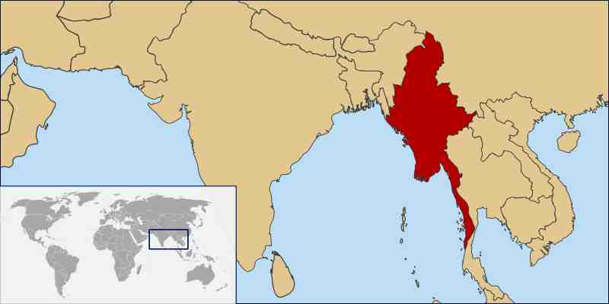
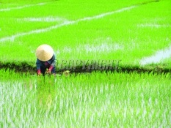
Tropical Storm LEDC
Cyclone Nargis, Burma
The cyclone happened on 2nd May 2008 at the Irrawaddy delta in Burma
Strong winds up to 135mph
• Storm surge of 7.6m
Heavy rainfall
The primary impacts included
-140,000 were killed
-450,000 homes
1700 schools were destroyed.
200,000 farm animals were killed
40% of food stores were destroyed.
Rice fields were flooded on the Irrawaddy Delta
The Government failed to warn its people. People were not evacuated in time
The cost of the damage was $10 billion.
The impacts were also greater in Burma than the USA because many in Burma depend on farming (crops and livestock) and much of this was totally destroyed
As Burma is a poor country it could not afford to plan, predict and prepare like the USA.
The emergency services were ill prepared, had little training or equipment and lacked numbers. The government refused to accept foreign aid at first as they said they could cope. Its government is a military dictator and they do not like outsiders! Aid workers were eventually allowed in, though this was three weeks after the cyclone.
The secondary impacts were that
up to 3 million were made homeless
millions lost their livelihoods.
-Over 70% of households didn’t have access to clean water and this caused diseases.
There was a shortage of food.
1000’s of temples were destroyed
Additionally, they do not have flood defences and their houses are poor quality and easily destroyed.

Slide 18
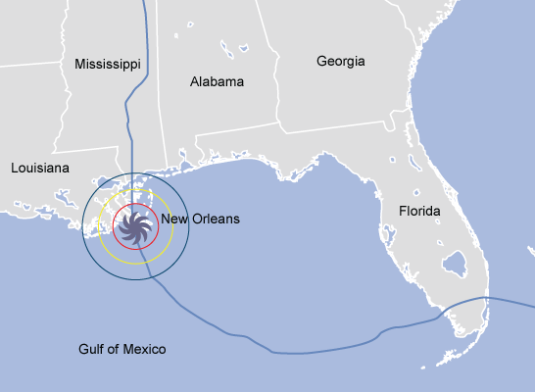
Tropical storms have strong winds and torrential rain. They are circular in shape and can be hundreds of km wide. They form over tropical seas (27oC or higher). Warm moist air rises and condenses. This releases energy which makes it grow really powerful. They lose strength as they move over land because their energy source (warm water) is cut off.
Tropical Storm MEDC
Hurricane Katrina, USA
Hurricane Katrina hit the South East USA on 29th August 2005 and cost a staggering $300 billion.
Katrina was a category 4 storm.
Storm surges reached over 6 metres in height.
New Orleans was one of the worst affected areas because it lies below sea level and is protected by levees.
People sought refuge in the Superdome stadium. Conditions were unhygienic, and there was a shortage of food and water. Looting was commonplace throughout the city. Tension was high and many felt vulnerable and unsafe.
The primary impacts included 1800 were killed and 300,000 homes were destroyed. 3 million people were left without electricity and bridges including the I-10 collapsed. Coastal habitats were also damaged.
The USA has a sophisticated monitoring system to predict if hurricanes will hit (satellites can track them). This means people can be evacuated. 80% were evacuated before the storm hit, reducing the death toll. Mississippi and Louisiana declared states of emergency and stockpiled supplies (food and water). The coastguard, police, fire services and army rescued over 50,000 people and they had access to equipment such as helicopters.
$50 billion in aid was
given by the government.
The secondary impacts were tens of thousands were made homeless and 230,000 jobs were lost from business that were damaged and destroyed. Water supplies were polluted with sewage, chemicals and dead bodies.
Although the response was better than in Burma the USA government received much criticism. Some homeless families ended up in sports stadia where conditions were intolerable and fighting etc broke out as tensions rose. There were accusations that as it was ‘black poor people mostly affected’ the government didn’t care. Looting was commonplace. Finally, flood defences that were supposed to protect New Orleans failed and this actually increased the damage as flood water became trapped
Oil facilities were damaged
and as a result petrol prices
rose in the UK and USA.

Slide 19
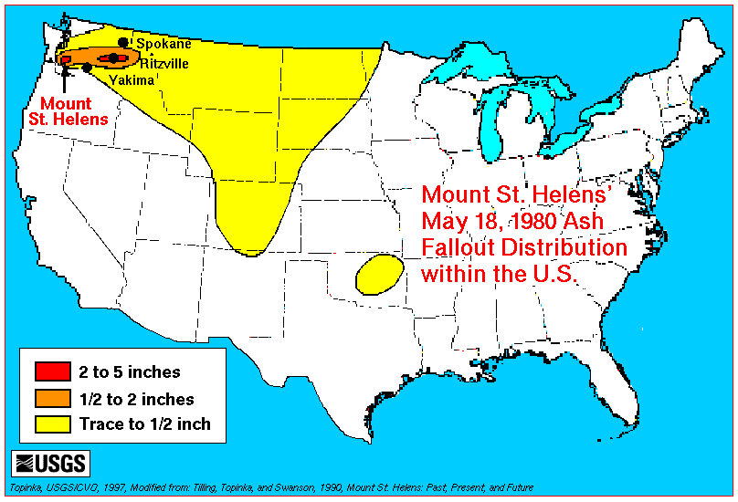
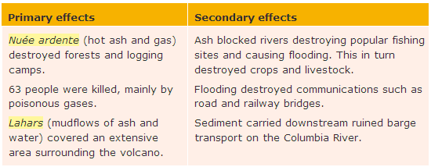
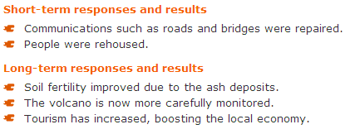
Mount St Helens is on the plate boundary between the Juan de Fuca plate and North American plate. When it erupted it permanently changed the surrounding landscape.
MEDC Volcanic Eruption
Mount St Helens, USA 1980
Mt St Helens was dormant for a long time but small quakes from 1980 suggested that the magma was moving. On March the 18th a quake in the volcano of 4.2 on the Richter scale signalled the volcanoes return to activity. A large “bulge” on the side of the volcano signified a build up of magma. On May 18 at 8:32 a.m., a magnitude 5.1 earthquake centred directly below the north slope triggered that part of the mountain to slide this was on of the largest landslides in history, it moved at around 110 mph and it covered about 24 square miles
This was a catastrophic
eruption, the biggest and
worst eruption ever to
hit the USA.
400 metres was blown off the top of
the mountain and a one mile horse
shoe-shaped crater was left that
was 500m deep.
200 homes, 47 bridges, 15 miles of railways and 185 miles of highway were destroyed. U.S. President Jimmy Carter surveyed the damage and stated it looked more desolate than a moonscape.
*Large number of wildlife were killed by the blast and the volcanic ash with nothing surviving in the blast zone * flooding resulting from blocked rivers washed away road and rail bridges * crops were ruined and livelihoods of loggers were devastated with large areas of trees being flattened like matchsticks
The cost of damage was $3billion

Slide 20
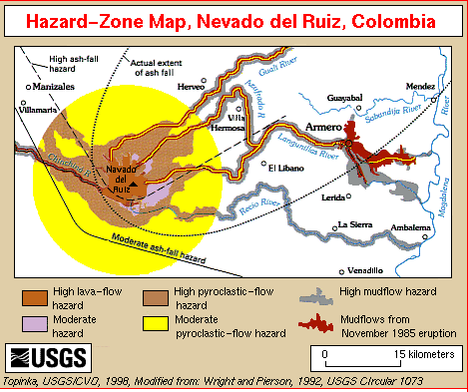
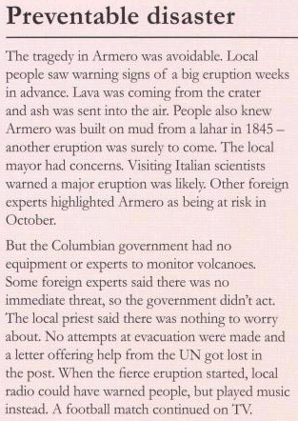
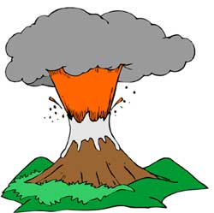
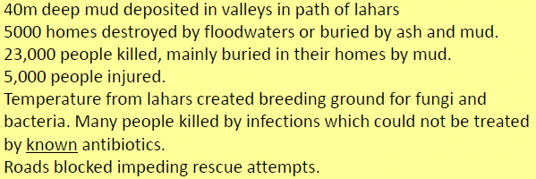
LEDC Volcanic Eruption
Nevado Del Ruiz, Colombia 1984
The worst-affected was the town of Armero. It was virtually destroyed - buried by mud and rubble swept down on to it. The fatal eruption happened during the night when most of the town's 27,000 residents were in bed.
An evacuation was ordered but abandoned when the volcano went quiet.
There were some warnings of increased
activity - in recent months there had been
rumblings from the crater, but the
authorities had told Armero residents it
was safe to remain in the city
-Pumice fragments and ash from side of vent.
-Lava erupted from summit crater accompanied by heavy rainfall.
-Hot ash and rocks transported by pyroclastic flows of clouds of gas and ash.
-Rapid snow melting causing floods to sweep loose debris and soil to create hot lahars down the mountain.
The Colombian government has appealed to the United Nations for help.
However, rescue efforts are being hampered by fallen bridges and impassable roads.
Eruption cost Columbia
US $7.7 billion – 20% of
the country’s GDP at
the time.

Slide 21
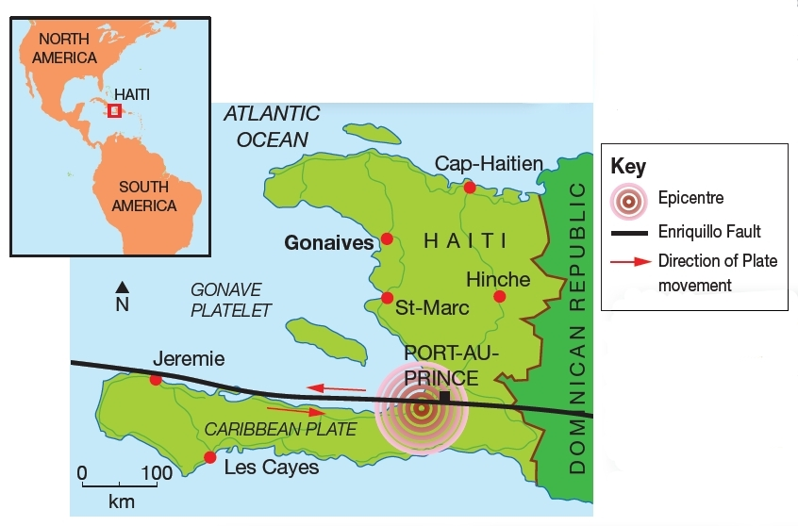
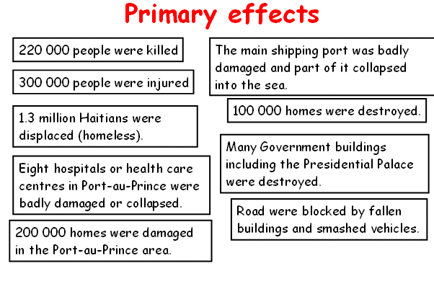
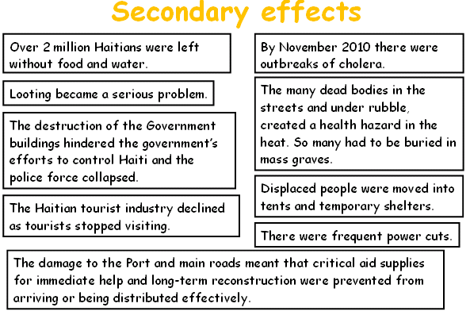
LEDC Earthquake
Haiti 2010
The country is located on a conservative plate boundary between the Caribbean Plate and the North American Plate.
3 Million people live in Port au Prince with the majority living in slum conditions after rapid urbanisation.
The poorest country in the western hemisphere. GDP is 143/227. 66% of the population of Haiti earn less than £1 a day with 56% of the population classed as “extremely poor”
- 12th January 2010 an earthquake measuring 7.0 on the Richter scale struck Haiti.
-The focus was 13km underground
-The epicentre was 25km from the capital Port-au-Prince
-Haiti suffered a huge number of serious aftershocks.
The number of people in relief camps of tents since the quake was 1.6 million
In July 2010, CNN returned to Port-au-Prince and reported, "It looks like the quake just happened yesterday“.
A January 2012 Oxfam report said that a half a million Haitians remained homeless
Only about 20% of aid has been spent by the Haiti government as they have no resources.
In early January 2010 the EU released €3 m in emergency funding.
The governments of the United States, Israel ,the Dominican Republic, Canada, Brazil, Italy and Cuba3 sent over 1,000 military and disaster relief personnel each, with the United States being by far the largest single contributor to the relief efforts.
The European Council and its member nations later announced more than €429 million in aid.

Slide 22
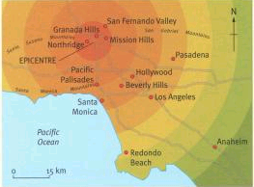
The January 1994 Northridge Earthquake struck hard: the first major earthquake to occur
directly beneath a highly urbanized area in California.
MEDC Earthquake
Northridge, USA 1994
Northridge was fairly prepared for earthquakes through education, rescue efforts and strong buildings.
The earthquake happened on a deep fault in the San Fernado Valley
Northridge is located
30km from Los Angeles
Measured 6.7 on the Richter Scale
Primary effects
57 people killed
9000 injured
Thousands of buildings damaged
Transport links damaged (roads)
Yet due to the earthquake happening early in the morning it reduced the deaths
Secondary effects
-Landslides
-Powerlines and waterlines damaged from the debris
-Extensive fires
Landslides were triggered in mountainous areas, these block roads and damaged homes
Wooden buildings were the buildings that generally collapsed
Fires broke out from the leaking gas pipes, areas were completely destroyed by the fires
It was declared a federal disaster, so 100s of workers from FEMA helped the community recover
Millions were given to the 600,000 people that applied for financial assistance.
15,000 aftershocks occurred, these can trigger the collapse of weak buildings
Near the epicenter in the San Fernando Valley, well-engineered buildings withstood violent shaking without structural damage
There were few casualties,
but economic cost was high
with losses estimated at $20 billion
Liquefaction occurred in some areas
The USGS monitor the movement yet can not predict , so preparation is key!

Slide 23
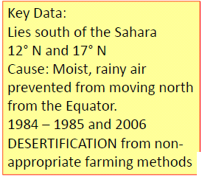
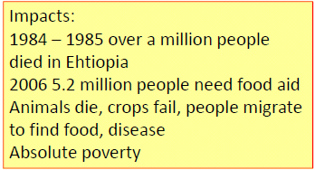
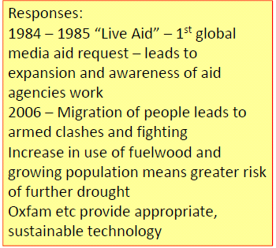
LEDC Drought (climatic problem)
The Sahel, Africa
The Sahel region of Africa has been suffering from drought on a regular basis since the early 1980s. The area naturally experiences alternating wet and dry seasons.
Drought is different from other hazards unlike floods and tropical storms it never kills people directly
Desertification – the turning of land, often through physical processes and human mismanagement, into desert. A severe threat to millions in the Sahel region of Africa.
In the Sahel, a drought is declared when there’s below average rainfall for 2 years. The Sahel has actually suffered drought for most of the last 30 years.
The result is crop failure, soil erosion, famine and hunger: people are then less able to work when their need is greatest. It becomes a vicious circle and can result in many deaths, especially among infants and the elderly. In Niger in 2004, the situation was made worse when a plague of locusts consumed any remaining crops. In these cases, people rely on food aid from the international community.
The Eden project is a charity that plants trees in the area to give food to the local people

Slide 24
Braunton Academy
GCSE GEOGRAPHY CASE STUDIES
RIVERS & COASTS

Slide 25
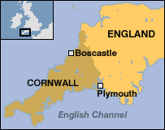
Boscastle is located in the county of Cornwall which is situated in the SW of the UK. Boscastle is a small village that only had 888 residents in 2001. A flash flood occurred on the Valency River in Boscastle on the 16th August 2004. The flood was extremely severe and was a 1 in 400 year event. Despite the devastating nature of the flood there was amazingly no deaths or serious injuries. This was largely due to the rescue efforts of 7 helicopters who airlifted 150 people to safety. However, about 100 cars, 5 caravans, 6 buildings and several boats were washed into the sea; approximately 100 homes and businesses were destroyed; trees were uprooted and debris was scattered over a large area.
Rebuilding Efforts after the 2004 Boscastle Flood
Since the 2004 flood, many things have been done to reduce the chance of flooding in the future. Some of the major improvements are: 2004 Buildings searched for victims
Debris removed from roads and river
Improved drainage built
Temporary bridge installed
2005 Shops and restaurants reopen
Water and electricity restored
Defences improved
Damaged buildings rebuilt
2006 Work to widen and straighten river
Car park raised
2007 Drainage further improved
Pipes for new sewers installed
New bridge installed
2008 Old bridge demolished
Harbour pavement concreted.
MEDC River Flood – Boscastle, UK 2004

Slide 26
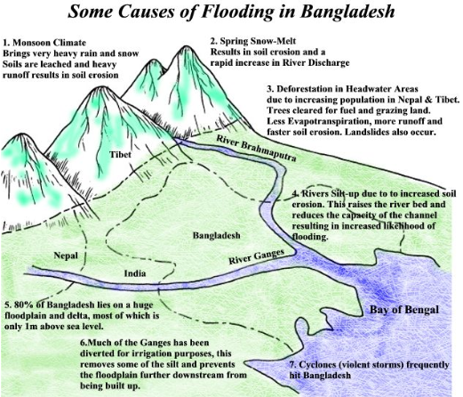
Bangladesh: Bangladesh is located in South Asia. On three sides it is surrounded by India and on the fourth is the Bay of Bengal. Bangladesh has a population of 156 million people, a population density of 1099 square kilometres and a GDP per capita of only $1900. Because of various human and physical factors, Bangladesh regularly suffers from floods.
Flooding in Bangladesh
Physical Causes Three major rivers flow through Bangladesh, the Ganges, the Brahmaputra and the Meghna
The south of the country is very low lying and is basically one big floodplain
70% of Bangladesh is less than 1 metre above sea level
Snow melt in Himalayas during Spring and Summer increases river discharge
Bangladesh experiences the monsoon season (tropical rains) every year from June to September
Cyclones can hit Bangladesh from the Bay of Bengal causing storm surges
10% of Bangladesh is covered in lakes and rivers
The Effects of the 1998 Flood Over 57% of Bangladesh's land surface was flooded
Over 1,300 people were killed
7 million homes were destroyed making 25 million homeless
Spread of water borne diseases like typhoid
Shortage of clean water and food - many rice paddies flooded (2 million tonnes of rice lost)
0.5 million cattle and poultry lost
Roads and bridges damaged
Total costs estimated at about $1 billion
Human Causes Deforestation reducing interception and increasing surface run-off
Urbanisation reducing infiltration and increasing surface run-off
Population growth increasing population density
Growth of informal settlements on marginal land (floodplains)
Dams in India causing sedimentation of rivers (reducing cross-section)
Poorly maintained flood defences
Poor transport and communication links (don't cause floods but prevent the population from being warned and evacuated)
Lack of weather warnings (again don't cause, but reduce warning times and give residents less chance to escape)
Global warming is causing more snow to melt in the Himalayas, it is causing sea levels to rise and it is increasing the frequency and magnitude of cyclones.
Short Term Management Boats used to rescue victims stranded on buildings and patches of dry land
Emergency water and food supplies distributed
Food supplied for surviving animals
Aid accepted from foreign countries
Tents and blankets provided for homeless
Basic repairs to houses and sewer systems
Long Term Management - Reduced rates of deforestation in the Himalayan foothills, - The building of seven large dams - cost up to $40 million and construction up to 40 years, - The building of 5000 flood shelters, - The building of 350km of levees (embankments), - Create flood water storage areas, - Developing flood warning scheme

Slide 27
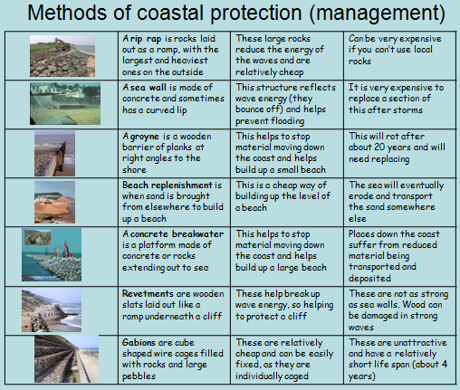
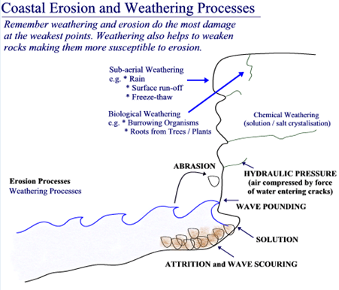
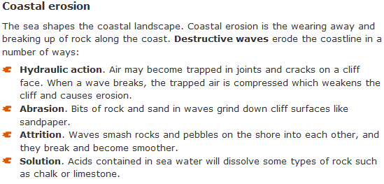
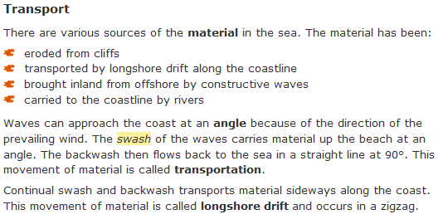
Coastal Processes
@
Westward Ho!
Westward Ho! is under threat from the sea. The 4 types of erosion are impacting on the coastline seein headland, bays, stacks, arches and stumps appearing as well as the wave cut platform. Westward Ho! is also impacted by longshore drift from SW prevailing winds taking material from Hartland point. The coastline needs management and protection for the future. - Maybe MANAGED RETREAT is an option?

