Slide 1
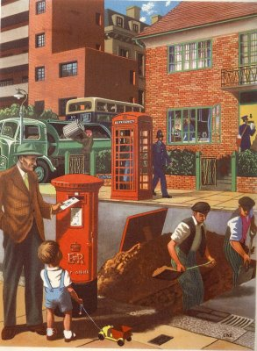
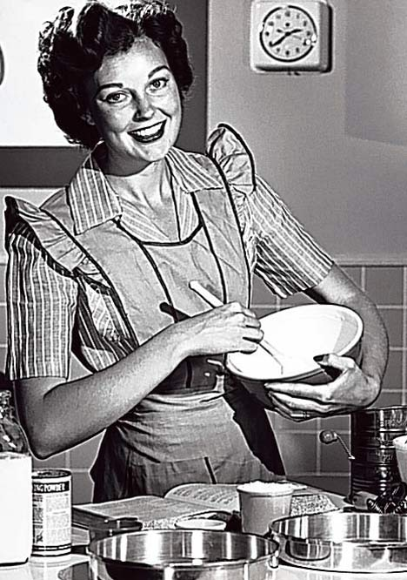
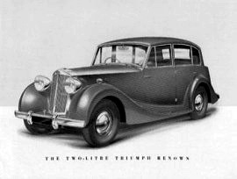
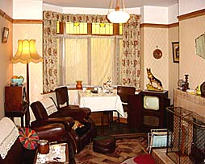
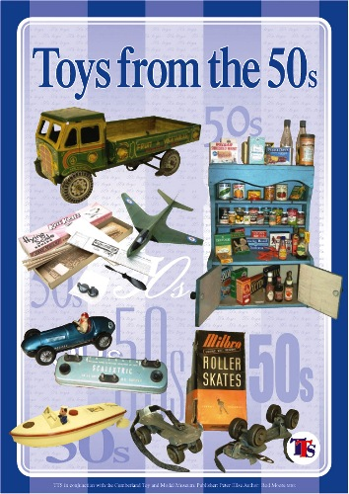
How do the 1950s
compare with life today?
The aim of this project is to investigate and compare life in Britain during the 1950s to life today. To complete some of the activities may take you longer than others. The activities are set out week by week but you can complete them in a way that suits you best.

Slide 2
Week 1 What was life like in the 1950s?
To help you with this section you need to watch the following clips on Youtube:
http://www.youtube.com/watch?v=QHL1LMw-SOY&feature=related
http://www.youtube.com/watch?v=_PDBp7umKng&feature=related
Using the film clips that you have watched and your own research write a detailed report finding out what life was really like in 1950.
In your diary you MUST talk about:
The money people earned and spent in 1950
Were private cars common?
What was public transport like in 1950?
What were the fashions in 1950?
What were the latest gadgets in 1950?
What did children do and wear in 1950?
To find the answers to these questions you should do some research, perhaps on the internet but also remember to interview the older members of your family, friends or neighbours. Personal stories from the period are often the most interesting.

Slide 3
Week 2 Interviewing somebody who was alive during the 1950s.
In this section of your project you are required to interview someone who was living in Britain in the 1950s. This can be a family member or a family friend.
Make sure that you ask questions that compare what life was like in the 1950s and what it is like now.
Write up your interview in a script format. Imagine that you are a journalist or radio presenter.
For your interview to be successful the following questions need to be directed at the interviewee:
What were you doing
in the 1950s?
B. How were things different in the 1950s? Which things do you think were better, and which were worse?
C. What were the key issues in the country at that time?
D. Do you believe Great Britain is a better place to grow up in now or back then?

Slide 4
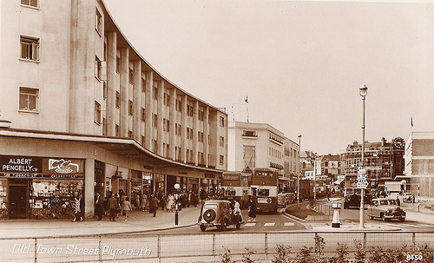
Week 3 What were towns like in Britain during the 1950s?
To help you with this section you need to watch the following clip on Youtube: http://www.youtube.com/watch?v=ilypgSE0G-0
Now you have a go!
You must design a new town from the 1950s!
You should include 1950s:
schools
houses
shopping parades
businesses
factories
public transport
entertainment (remember there were no discos and nightclubs in most places in 1950).
Write a set of notes explaining the main
features of your design.

Slide 5
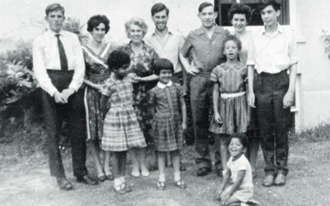
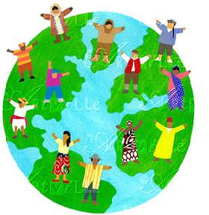
Week 4 How does religion in the 1950s compare with today?
To help you with this section you need to watch the following clip on Youtube: http://www.youtube.com/watch?v=F40qEK_F7ho
Although Britain is considered to be a Christian country it is very clear that we live in a multi-cultural society. Since the 1950’s there has been a steady growth in the number of Muslims living in Britain, with it now being the second largest religion in Britain as we can see from the clip.
Your task
Carry out a study into Islam.
Produce a report on your findings which uses a variety of visual and written information, and covers at least two of the following;
Beliefs
Festivals
Key Figures/leaders
Sacred Buildings/places
Holy Books/Writings
Moral Codes.

Slide 6
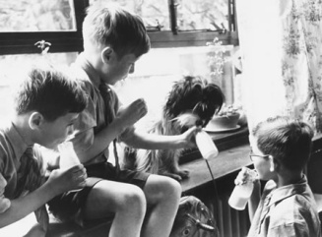
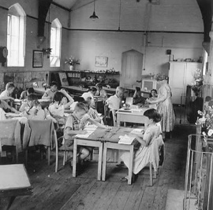
Week 5 Were school life and career opportunities better for children in Britain in 1950 or now?
You are going to write a report on school life and career opportunities in Britain in 1950. The following information should help guide you through what you need to do.
Objectives:
To further develop our skills in research.
To develop knowledge on how school life and work has changed since 1950.
To evaluate whether career opportunities are better now for all pupils than they were in 1950.
Planning
1a) Were school life and career opportunities better for children in 1950 compared to now?
This will be the “question” you will be looking to answer by the time you have collected your research.
How will I find out the information?
What tools/ equipment/ help will I need?
How long will it take?
Issues to find out about
1b) Areas you will need to find out about are:
How did pupils apply to get into secondary school (what was the 11 plus exam?)
How could the school you went to have an impact on your future career?
Did girls and boys do the same subjects?
What was meant by the “3 Rs”?
How were pupils punished for doing something wrong?
Are there any subjects that were taught then, but are not taught now?
Are there any subjects that are taught now, but was not taught then?
How were the career opportunities for girls different to what they are now? Include work, sixth form college and university.

Slide 7
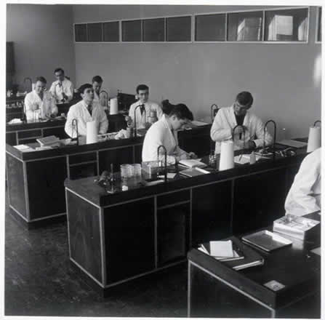
Your report should be a summary of what you were researching, how you researched it, and what the answers were. Your basic outline of the report should be as follows:
Say what your research question is (My research question is…).
Write what you were going to find out.
Where did you plan to get your information from and did you manage to get it?
What did the information say about school life and career opportunities in the 1950s Britain? How is this different to now?
Include people’s experiences of their life at school and the careers that were available to them.
Include different views and opinions from the people you have spoken to and what you have read on what things are better now than they were in 1950, and the other way round.
Has this exercise changed your view in anyway about how you see your life at school and what opportunities you have for your future?
Write a conclusion at the end of the report that clearly relates to your research question (i.e., in two or three sentences what was the answer to your “research question”?)

